Slide 1

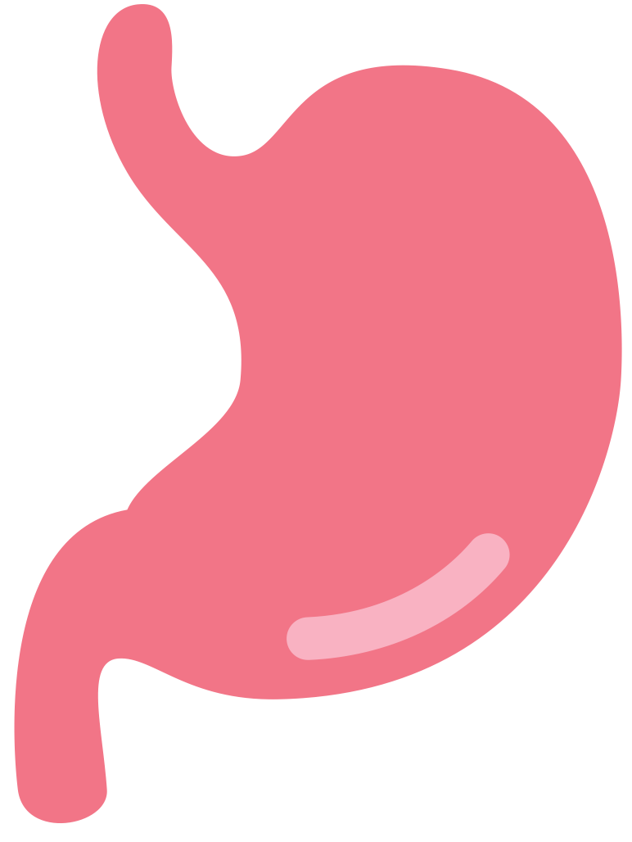
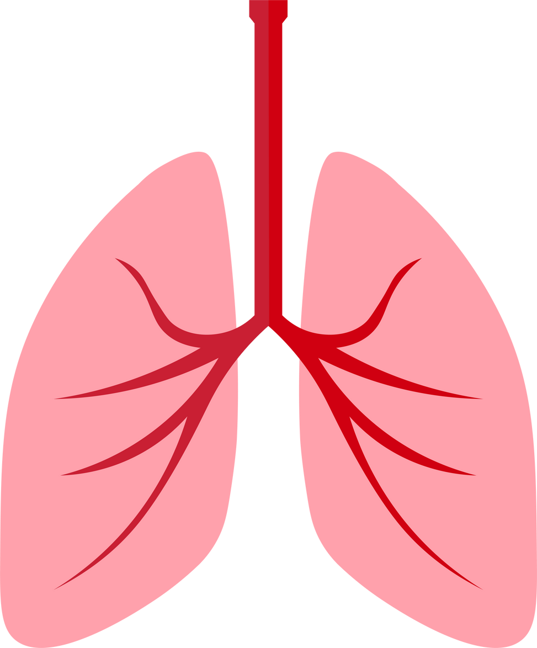
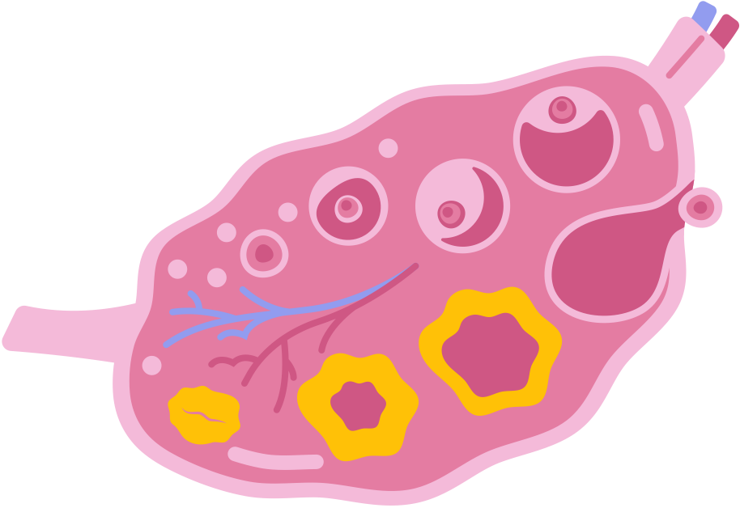

Organ-Link-Heros System
Exploring the implementation of a communication ecosystem for multi-party application -
Group 6
Chiu Wan Yu
Hao-Chun Hsieh
Huang Ing-Ruei
Zhang Shuai

Slide 2

outline
0
Description
UML class diagram
01
04
02
Approach & Innovation
WorkFlow
05
03
High Level diagram
Demo
c
06

Slide 3
Description
The global health system faces a severe challenge—organ demand dramatically exceeds organ supply. Thousands of patients die each year while waiting for transplants, and the shortages are even more acute in low-income regions where medical infrastructure limitations worsen inequities. Compounding this issue is the existence of illegal organ trafficking networks, which exploit vulnerable populations and undermine ethical medical practices.
Meanwhile, countries such as the United States, Spain, and South Korea have developed advanced organ donation systems and have large populations of willing donors. These nations can play a crucial role in improving global organ allocation if a coordinated, ethical, tech-driven system is established.
OrganLink Heroes aims to bridge these gaps. Our application is designed to streamline global organ donation requests, ensure safe verification and matching, and coordinate transportation and storage using modern medical technologies and secure digital infrastructure.

Slide 4
Approach & Innovation
Problem
How can we design a scalable and ethically compliant global platform that connects organ donors, transplant centers, and patients, reduces black market dependency, increases transparency, and ensures reliable transportation and medical quality control?
Solution
OrganLink Heroes is a secure, user-friendly, globally scalable platform that connects verified organ donors, beneficiaries, hospitals, and regulatory agencies. It addresses the challenges of organ availability, ethical compliance, cross-border transport, allocation fairness, and logistics.
The platform’s modular design enables seamless operation across regions with differing medical infrastructures, creating a flexible system capable of combating illegal organ trade while improving legitimate transplant access.

Slide 5
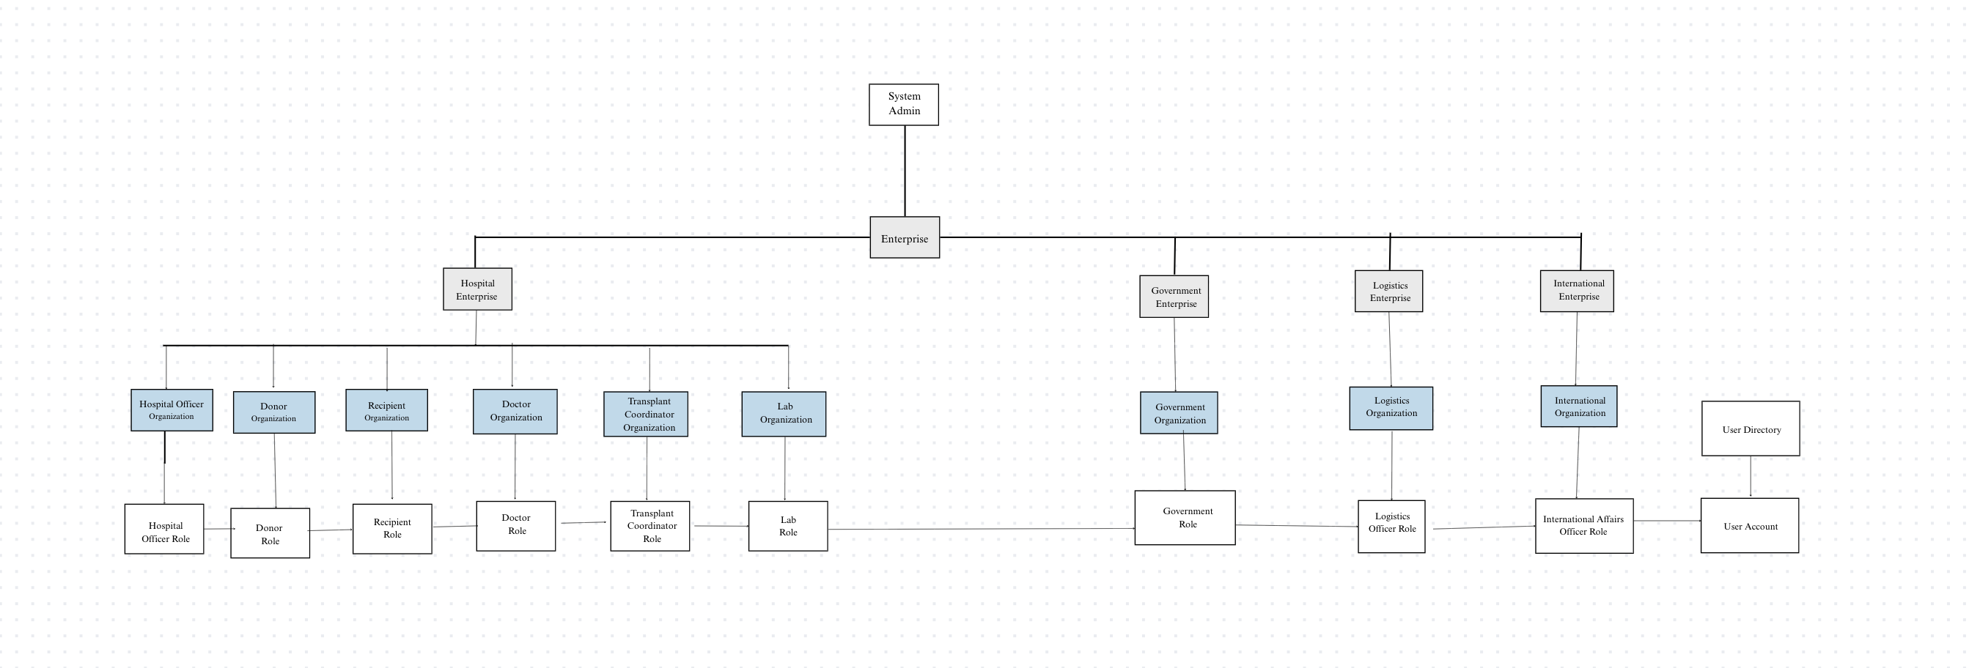
High Level diagram

Slide 6
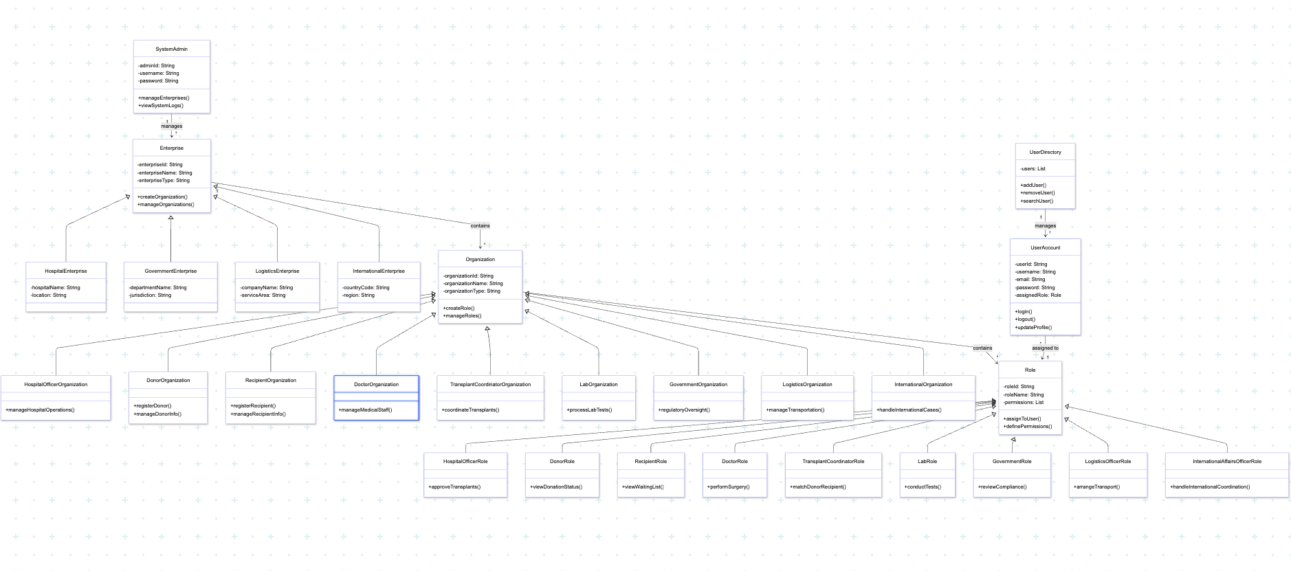
UML class diagram

Slide 7
WorkFlow
Workflow 1: Donor Registration and Initial Approval
Description: A potential organ donor registers their personal and basic medical information. This registration is then reviewed and initially approved (or rejected) by a Hospital Officer within the relevant Hospital Enterprise. A System Admin can monitor all registrations.
Workflow 2: Recipient Organ Request and Initial Matching
Description: A patient registers as a potential organ recipient, specifying their medical needs. A Transplant Coordinator reviews this request and initiates an automated search for compatible donors based on basic criteria like blood type and organ type.

Slide 8
WorkFlow
Workflow 3: Medical Test Result Upload and Verification
Description: After a donor is approved and a recipient has an initial match, specific medical tests are required. A Lab Technician uploads the results, and a Doctor reviews and formally verifies them.
Workflow 4: Organ Logistics Request and Assignment
Description: Once an organ match is fully medically verified and confirmed, a Transplant Coordinator requests logistical support to transport the organ. A Logistics Officer then assigns a transport vehicle and team.

Slide 9
WorkFlow
Workflow 3: Medical Test Result Upload and Verification
Description: After a donor is approved and a recipient has an initial match, specific medical tests are required. A Lab Technician uploads the results, and a Doctor reviews and formally verifies them.
Workflow 4: Organ Logistics Request and Assignment
Description: Once an organ match is fully medically verified and confirmed, a Transplant Coordinator requests logistical support to transport the organ. A Logistics Officer then assigns a transport vehicle and team.

Slide 10



Thank you !

